Slide 1
Acreage Estimation and Uncertainty Quantification (Capstone Project)
Luca Sartore, Ph.D.**
January 30, 2026
**Disclaimer: The findings and conclusions in this publication are those of the authors and should not be construed to represent any official USDA or U.S. Government determination or policy.

Slide 2
Planted Acreage Estimation
Acquire CSB Data Publicly available Crop Sequence Boundaries datasets
Identify Other Sources of Information CSB attributes and other information to model farmers’ planting decisions
Predict the Next Crop Type Train and validate a classification model and predict the next crop type
Aggregate by Region Summarize acreage for each crop type at the county and state level
Estimate Variance Provide a measure of uncertainty for the acreages

Slide 3

Crop Rotation Models
Auxiliary Data
Auxiliary Data
Auxiliary Data
Past Crop Rotations
Prediction

Slide 4
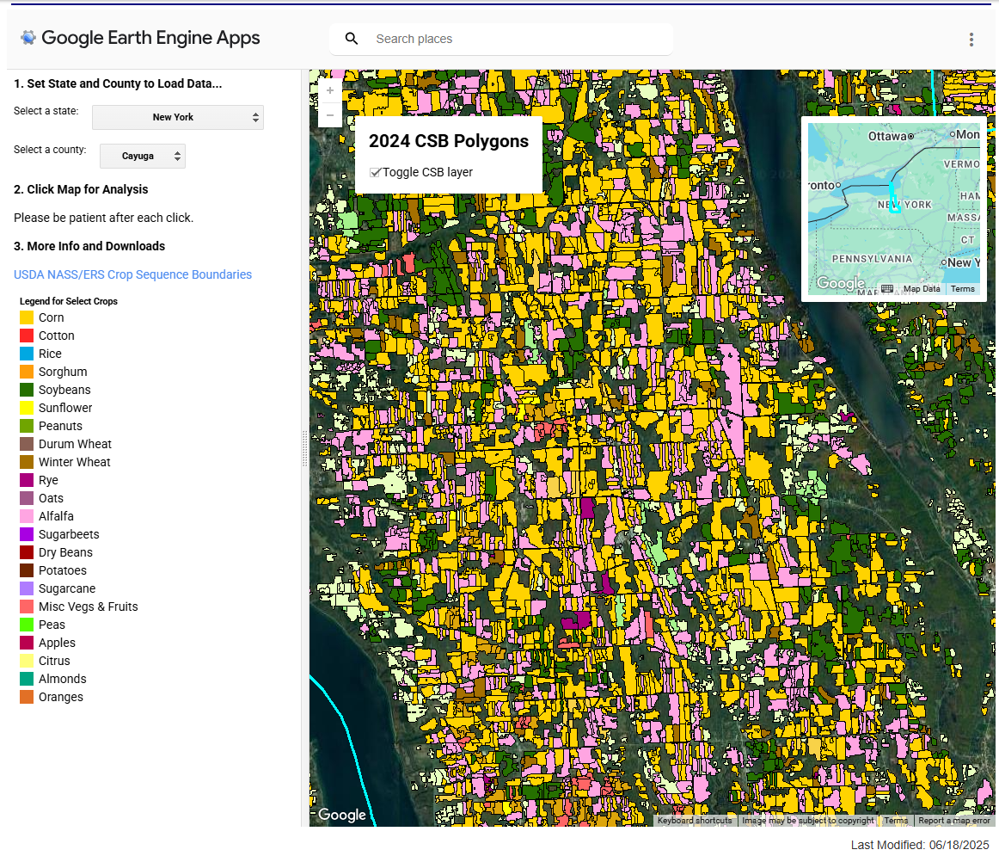
Crop Sequence Boundaries (CSB)
CSB data are publicly available at https://www.nass.usda.gov/Research_and_Science/Crop-Sequence-Boundaries/index.php
Metadata contains additional information useful to the final user (see https://www.nass.usda.gov/Research_and_Science/Crop-Sequence-Boundaries/metadata_Crop-Sequence-Boundaries-2024.htm)

Slide 5
Useful Auxiliary Information
Economic factors
Costs of seeds, fertilizers, …
Future prices of crops to be planted
Weather events
Precipitations (operational farming constraint)
Temperatures (biological constraint of the crop – maximizing yield)
Soil factors
Drainage, soil moisture, and soil type
Irrigation
Carbon content

Slide 6
Where to Get Additional Data
Google Earth Engine https://earthengine.google.com/
CropSmart https://cat.csiss.gmu.edu/CropSmart
QuickStats https://catalog.data.gov/dataset/quick-stats-agricultural-database
Farmers.gov https://www.farmers.gov/dashboard/new-york
NRCS Data Gateway https://datagateway.nrcs.usda.gov/
GIG New York State https://opdgig.dos.ny.gov/
Cornell Data Library https://guides.library.cornell.edu/ag-food-data-guide/ag-food-data-tools

Slide 7
Obtaining Data And Making Ready for Analysis
Data hunt
Download data
Data wrangling
Exploratory/Descriptive Data Analyses

